Slide 1
MICROSOFT MOVIE STUDIO
Redefining Cinematic Excellence

Slide 2
Outline
Goal
Data
Methods
Results
Recommendations

Slide 3
Goal
Microsoft is looking to venture into the movie industry and they want it to be profitable and rival the other players in the industry.
It is my role to analyse data from other movie site to bring out the factors that make a movie studio stand out and capture its customers’ attention.
To achieve this, we look at how the ROI, Genre and star appeal add up to a studio’s success.

Slide 4
Data
For this project, I utilized data from the following sources:
Box Office Mojo
IMDB, Rotten Tomatoes
TheMovieDB
The Numbers
This data encompasses comprehensive details about movies, such as the key individuals involved in production, genres and financial metrics

Slide 5
Method
The first step involved acquiring the necessary data and organizing it into DataFrames. Although the initial data lacked significant utility on its own, I used SQL to merge the DataFrames and enhance their relevance.
Next, I performed data cleaning operations, converting financial values into floats and eliminating duplicated and missing data.
To facilitate analysis, I introduced a new column to calculate the ROI. Finally, I visualized the data using matplotlib and seaborn libraries.

Slide 6
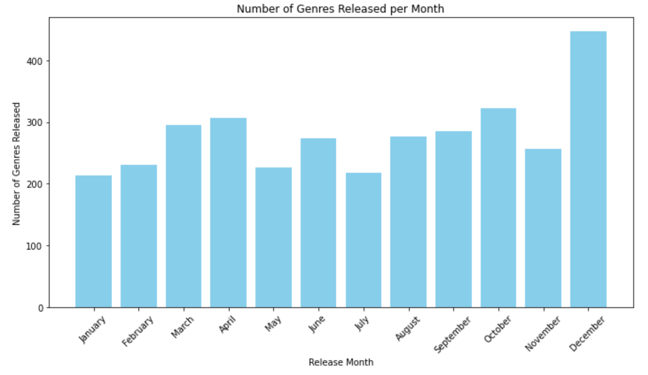
Results
Months with the highest movie releases are December, October, April, March, June, August and November respectively

Slide 7
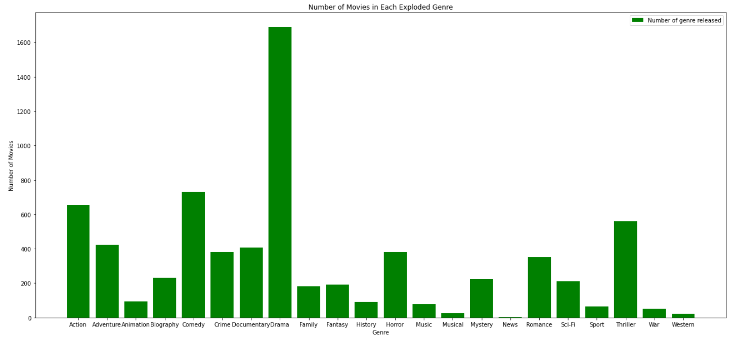
The first graph shows that the genre drama had the most releases followed by comedy and action while the second graph shows that the most released grouped genres are 'comedy,drama', 'drama,romance', 'comedy,drama, romance' and 'action,crime,drama'.

Slide 8
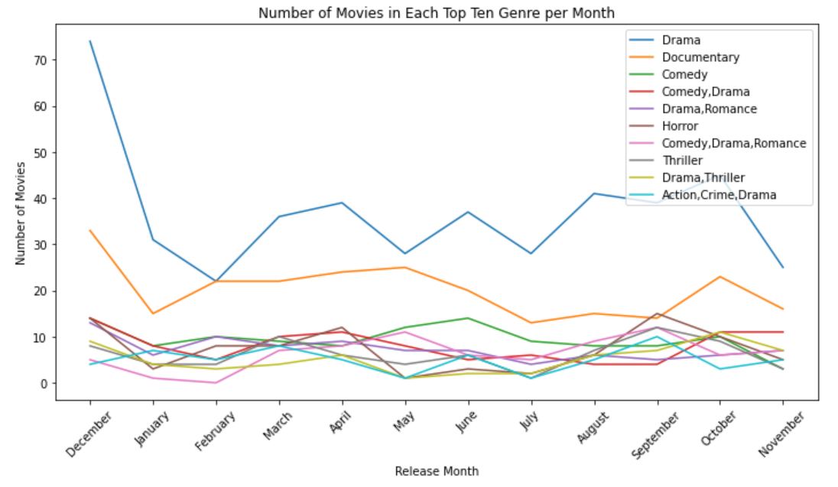

Slide 9
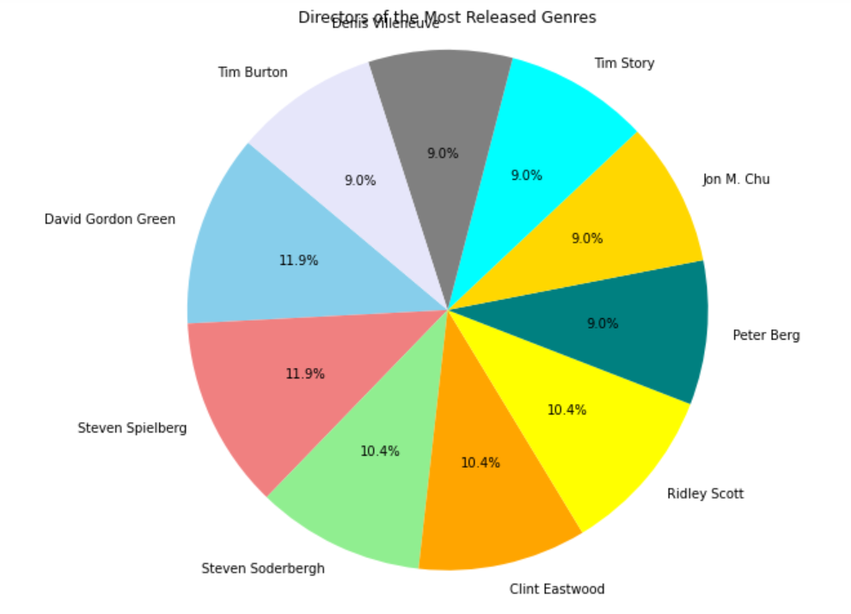
The movie production industry
is dominated by few directors.
These directors produce the most
released genres we earlier identified.

Slide 10
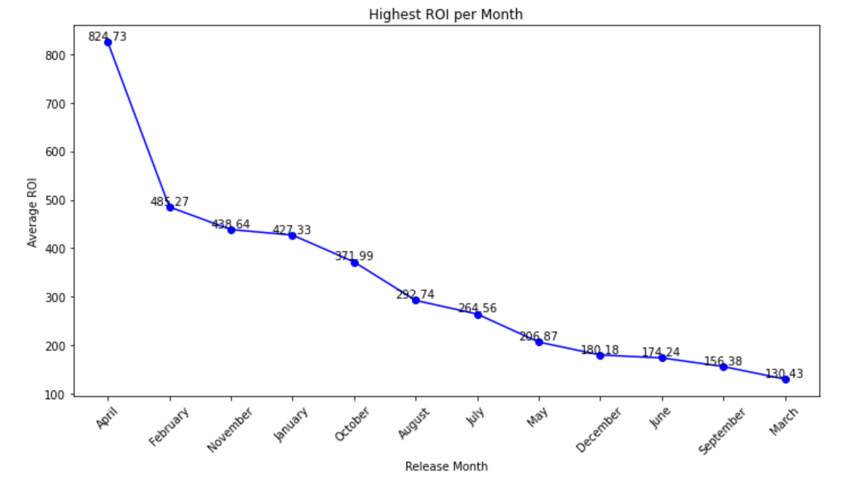
April had the highest roi followed by July, December, May, November, June and January respectively. Having a closer look at the month of April, I see that despite not being the month with the highest genre releases, with the genre released in that month being a combination of Comedy, Drama and Horror with its director being Graham Wright.

Slide 11
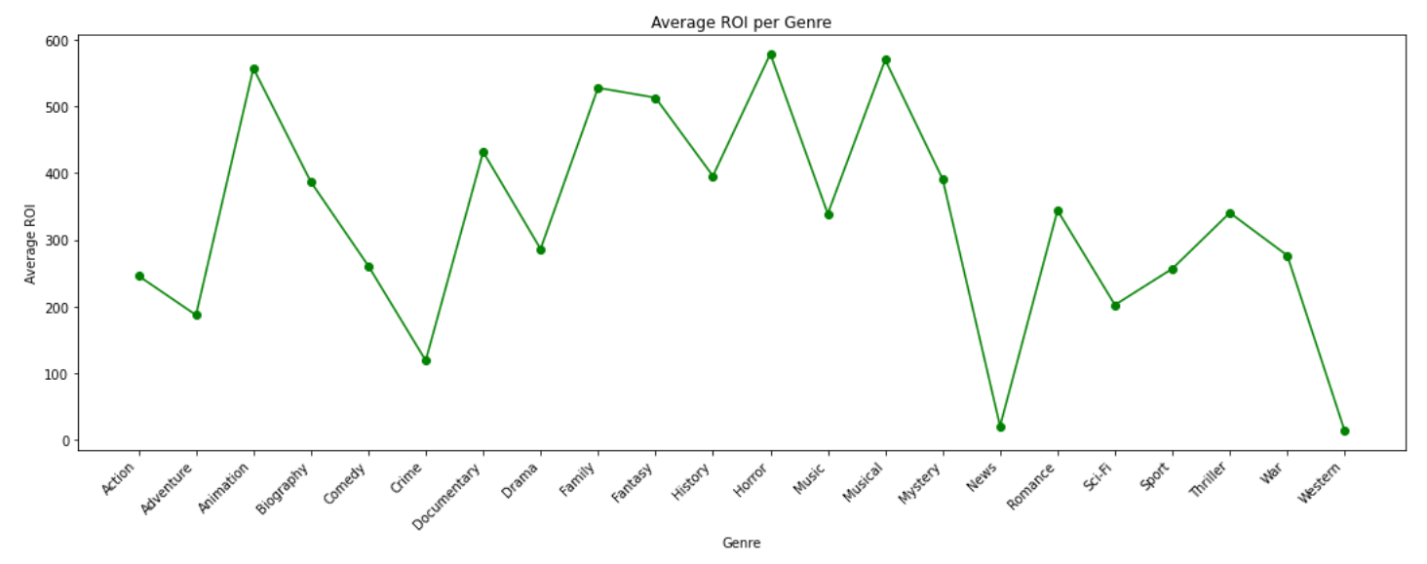
The below line graph reveals that the some of the genres with the highest roi are horror, musical, animation and family. I find this quite strange given that these are not the same genres I find under mostly released genres per month.

Slide 12
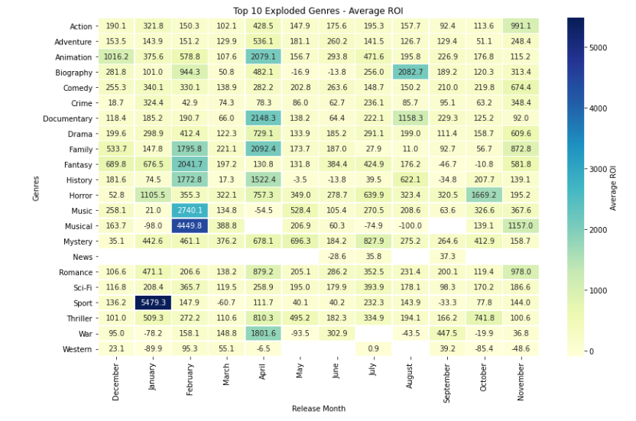
The below heat map shows
that from a closer look, contrary
to the above line graph, the sport
genre had the highest ROI.
This could be due to the low
investment/budget put in this movie
genre compared to horror.

Slide 13
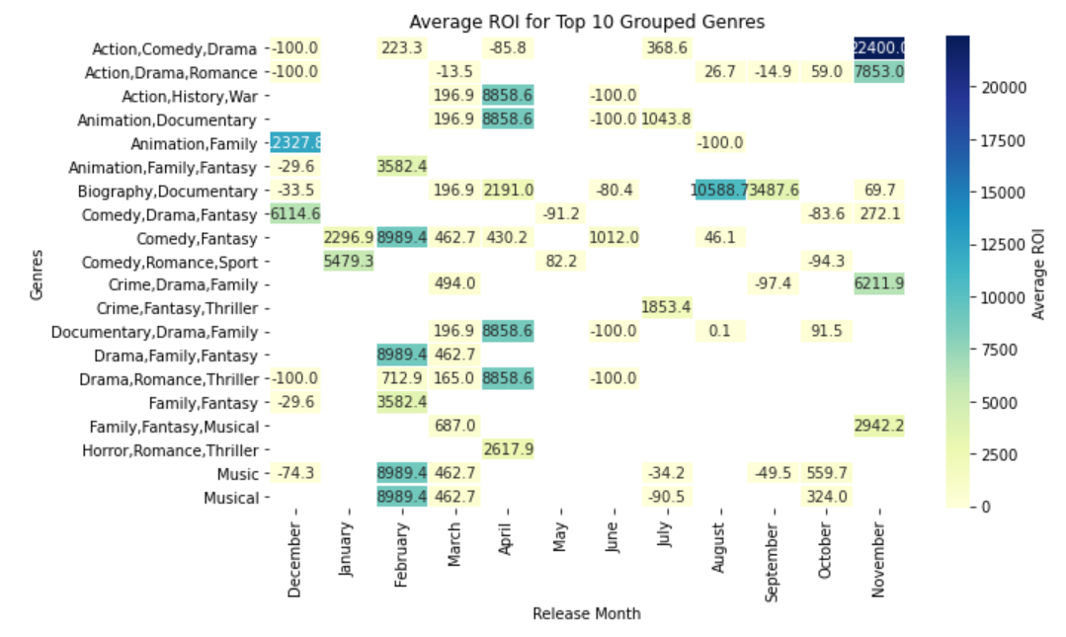
I found that when movies
released have combined genres,
the ROI is much higher. An instance
is where a combination of action,
comedy and drama have the
highest ROI.

Slide 14
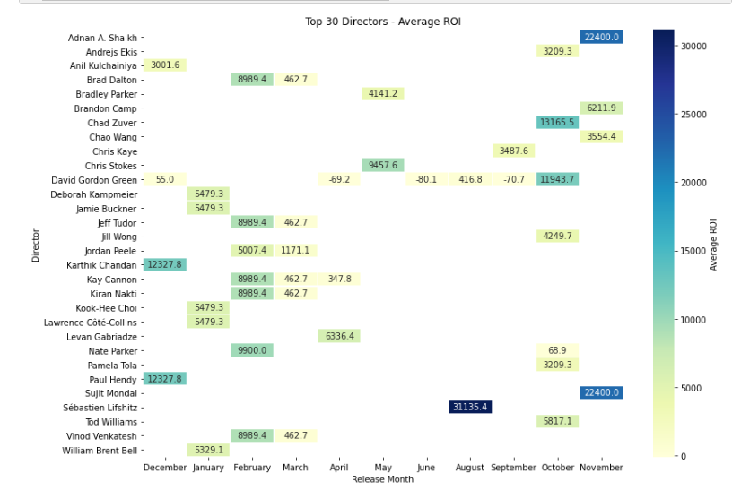
Top 30 directors with the highest ROI
in our dataset directed movies
with genres as follows Biography,
Documentary, Action, Comedy, Drama,
Romance, Horror, Animation, Family, Sport,
Fantasy and Musical. Their main release
months are January, February, March,
October, November and December.

Slide 15
Conclusion
Profitable opportunity in movie industry for Microsoft:
High budget ≠ High ROI
Combined genres = Potential success, best release months: Dec, Nov, Oct
Focus on animation, horror, musicals = High ROI, low budget
Consider experienced directors: S. Soderbergh, S. Spielberg, D. Gordon Green, S. Lifshitz, S. Mondal, A. A. Shaikh, K. Chandan, C. Zuver"

